Slide 1
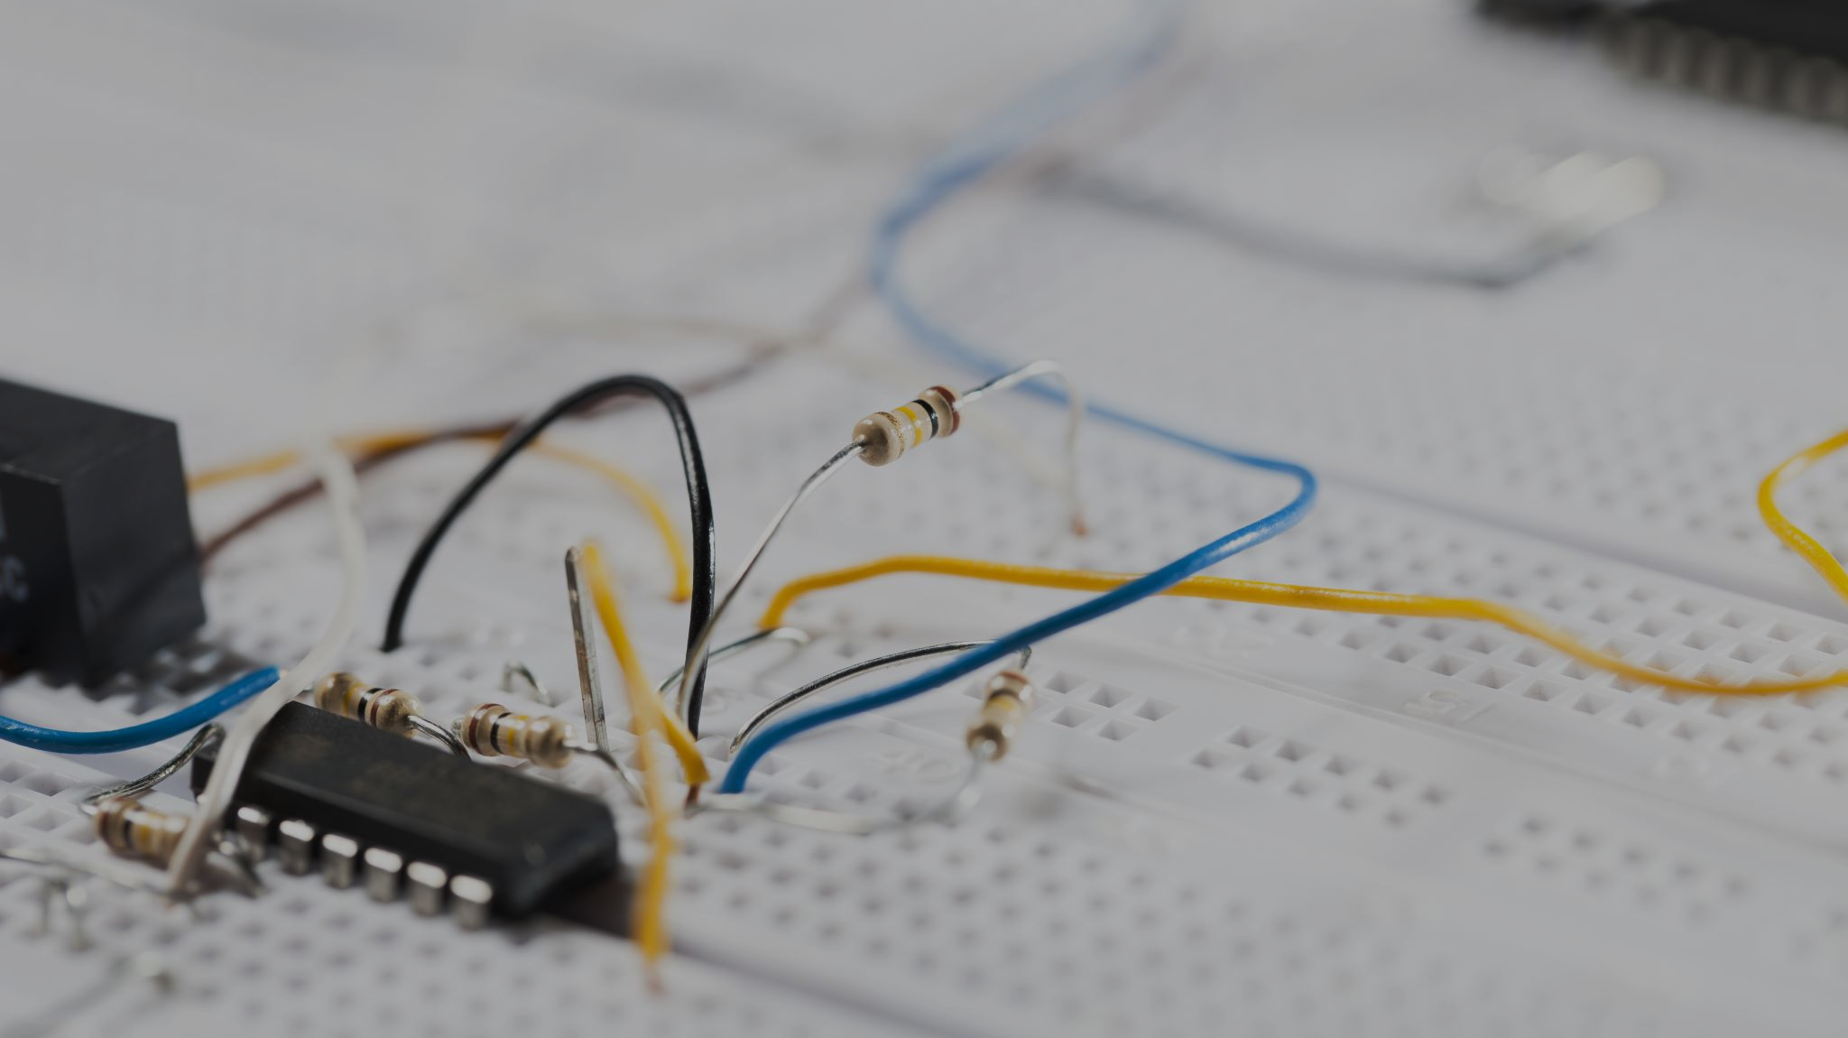
Arduino Uno
Computer Science Summer Camp 2025

Slide 2
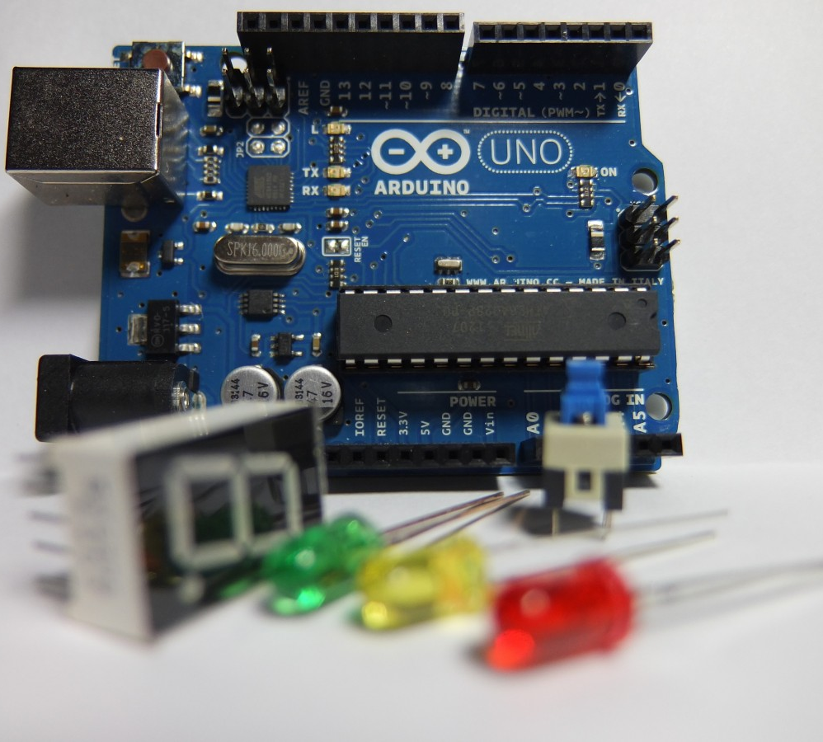
What we will cover
What Arduinos actually are.
What you can make with them.
How to program with them.
Doing even cooler stuff with them.

Slide 3
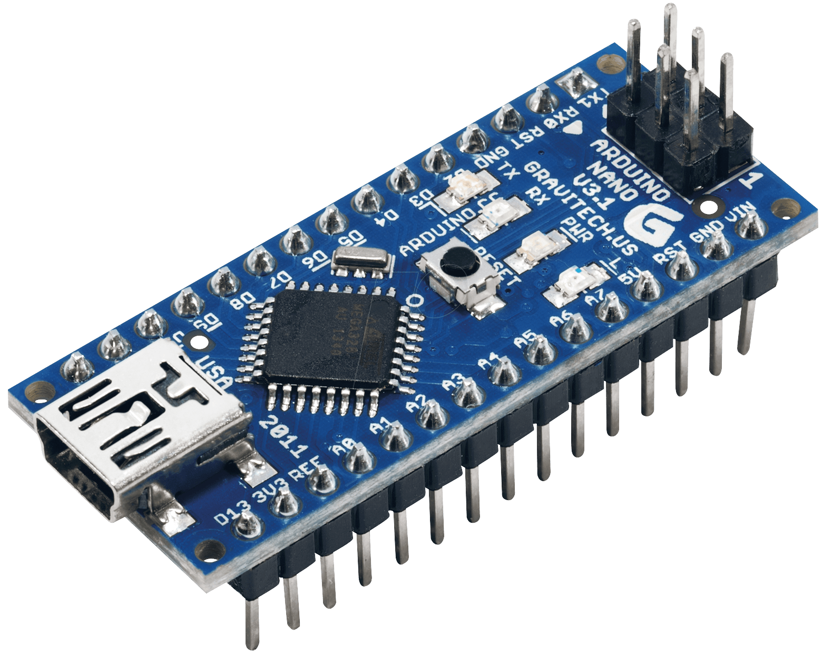
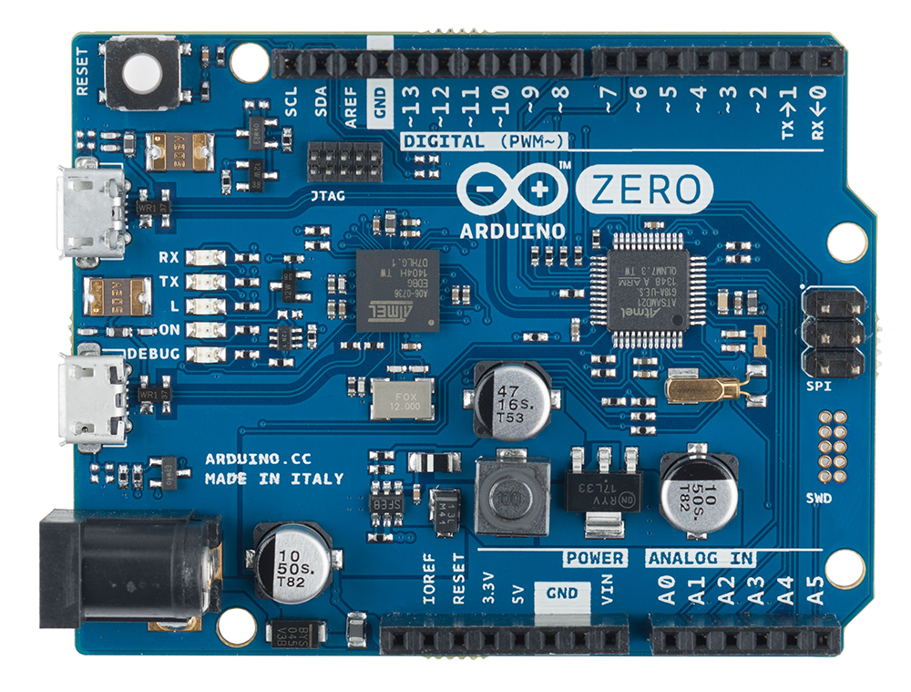
Introduction
Arduino (the company) make special kinds of computers called Microcontrollers.
They are small, modular computers that can be programmed to do basically anything.
Arduino make many kinds of microcontrollers, some even have WiFi, Bluetooth and Screens!
We are using the Arduino Uno today.

Slide 4
Uses for Arduino
Arduinos are used in thousands of projects all the time. They are pretty cheap compared to other options like Raspberry Pi’s and you can get so many different versions of them for different things.
Some come with WiFi and can connect and communicate over your networks. This works great for some projects that need to be wireless.
Arduinos
Home automation devices
IoT devices
Control boards for robots

Slide 5
Programming
What we use
How it works
If you need help
Arduinos are programmed in sketch
The language is pretty similar to C / C++
Sketch is a lot easier to use for projects and has libraries to help you do things.
First you write your code in the Arduino IDE
Then you verify your code to make sure you dont have any errors
Finally, you upload your code to the arduino over a USB cable
Don’t be afraid to Google things.
If you need some examples, have a look on the computers.
If you still need help, call over a demonstrator

Slide 6
Safety - General
Electricity can be dangerous
How to be safe
Things can heat up if you short them. Be careful when connecting wires.
Microcontrollers do not like water. Do not get them wet.
Digital electronics care about polarity. Don’t plug things in backwards.
Connect your battery after connecting things to your circuits
Move all drinks away from any electronics.
Make sure to plug batteries in the correct way.

Slide 7
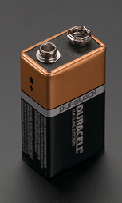
Safety – Batteries and Polarity
Why Polarity Matters
Negative Terminal
Polarity is really important when working with digital electronics like Arduinos. If we connect things backwards we can break parts of our circuits.
LEDs, Diodes and batteries have a polarity. They need to be plugged in the right way to work. Sensors and resistors usually don’t care.
5V / VCC / + are different ways of saying the positive side of a circuit. These wires are usually red
0V / GND / - are different ways of saying the negative side of a circuit. These wires are usually black
Positive Terminal

Slide 8
Projects we will cover
Blinking Light
Let’s make the light on our Arduino blink!
Use a temperature sensor to see how warm it is in the lab.
Automatic Light
Make a light turn on when it gets dark (or you put your hand over it).
Displays
Show some text on an external screen.
Displays (extra)
Show some more text and make it scroll like on a bus or train.
Temperature Logger

Slide 9
Additional content
Subtitle
Subtitle
Subtitle
Add text, images, art, and videos.
Add transitions, animations, and motion.
Save to OneDrive, to get to your presentations from your computer, tablet, or phone.
This PowerPoint theme uses its own unique set of colours, fonts, and effects to create the overall look and feel of these slides.
PowerPoint has tons of themes to give your presentation just the right personality.
Open the Design Ideas pane for instant slide makeovers.
When we have design ideas, we’ll show them to you right there.

Slide 10
What you will need
✅: Needed
❌: Not Needed
➖: Optional
 | Blinking Light | Temperature Logger | Automatic Light | Displays
Arduino Uno | ✅ | ✅ | ✅ | ✅
Resistors | ❌ | ❌ | ✅ | ❌
Appropriate Sensor | ❌ | ✅ | ✅ | ❌
LCD Display | ❌ | ➖ | ➖ | ✅

Slide 11




Summary
With PowerPoint, you can create presentations and share your work with others, wherever they are. Type the text you want here to get started. You can also add images, art, and videos on this template. Save to OneDrive and access your presentations from your computer, tablet, or phone.

